Slide 2
Prepared by
Dr. T. Sunand Emmanuel
Assistant Professor, H&SS Department

Slide 3
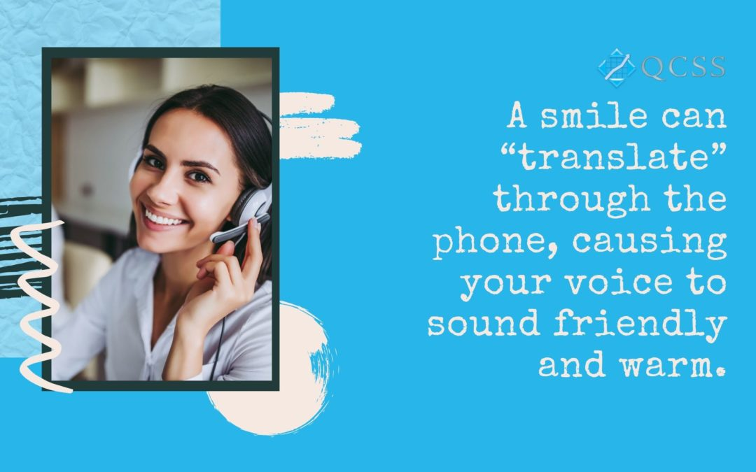

Slide 4
Telephone etiquette
Answer the call within three rings.
It is polite and customary.
Immediately introduce yourself.
Hi, this is [Your first name] from [Your company]. How can I help you?"
Speak clearly.
Do not speak fast. Ask if the other person has understood. Slow down. Ultimately the other person has to understand your message

Slide 5


Slide 6
Only use speakerphone when necessary.
Actively listen and take notes.
Use proper and grammatically correct language.
Remain cheerful. Have a smile.

Slide 7
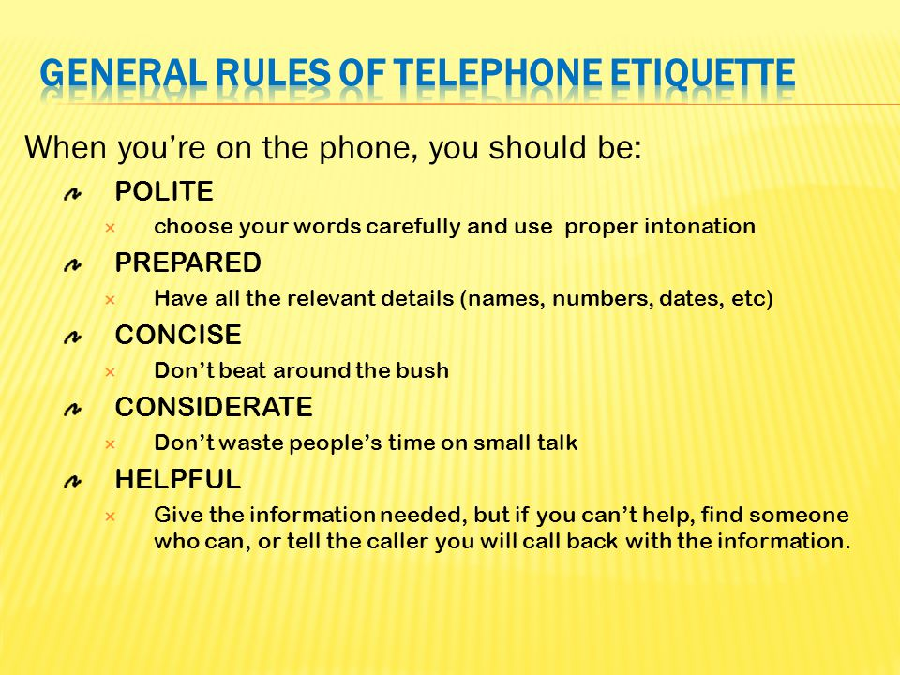

Slide 8
Ask before putting someone on hold or transferring a call.
Take permission.
Could I please put you on hold?
Just a second. I will connect you.
Be honest if you don't know the answer.
Don’t lie or be dishonest with your answers.
Be mindful of your volume.
Do not shout. Be aware of others around you.
Check for and respond to voicemails

Slide 9


Slide 10
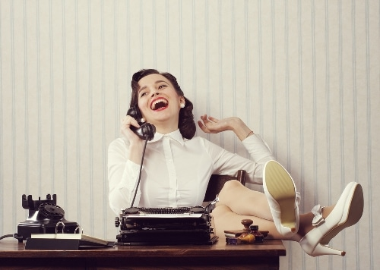

Slide 11
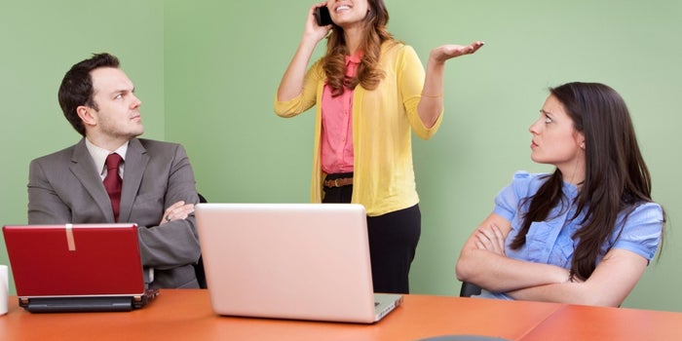

Slide 12
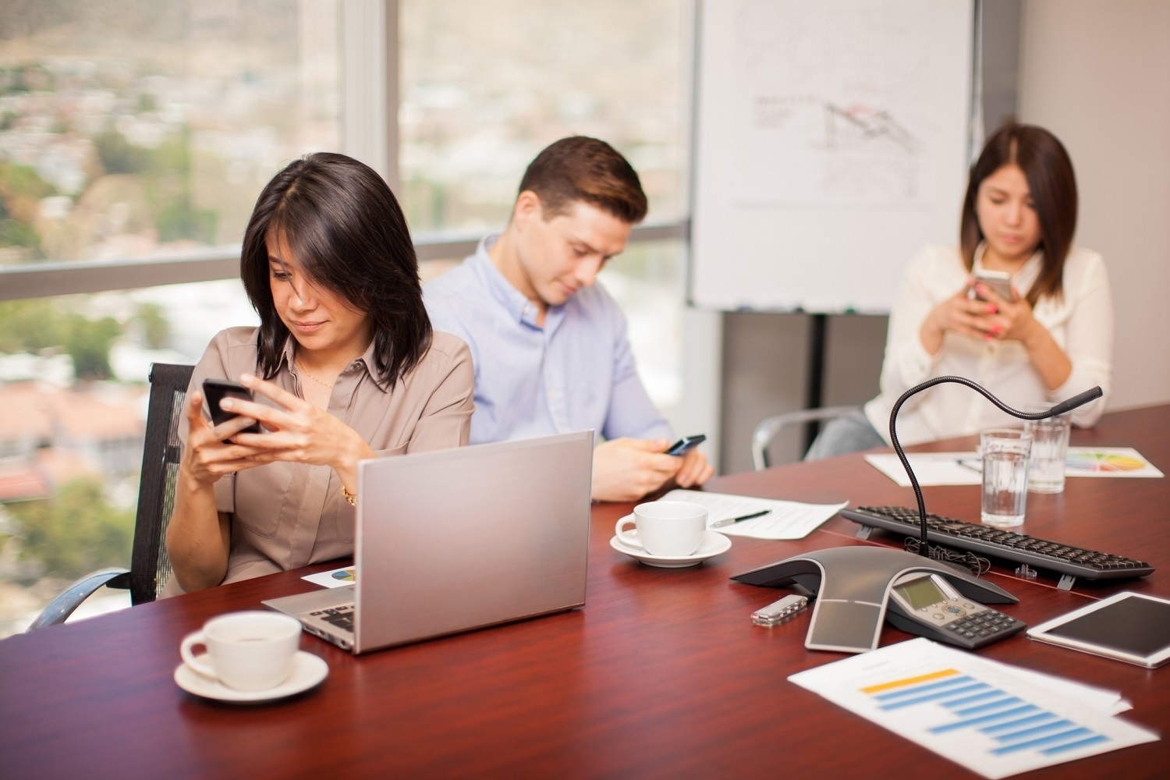

Slide 13
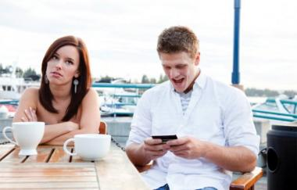

Slide 14


Slide 15
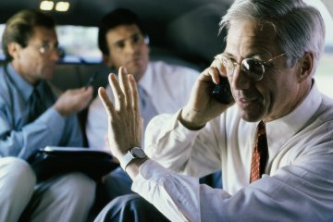

Slide 16
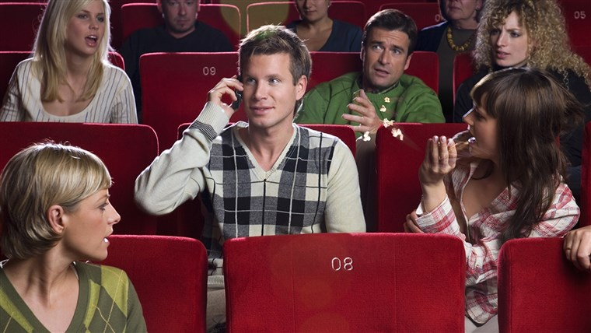

Slide 17
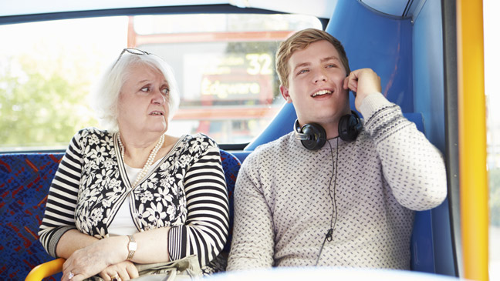

Slide 18
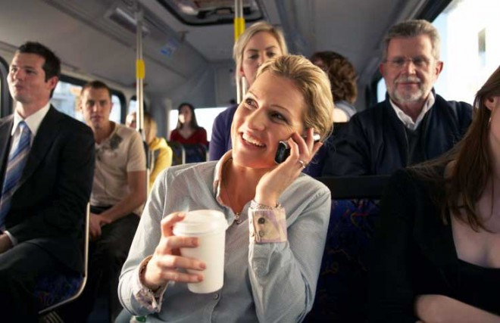

Slide 19
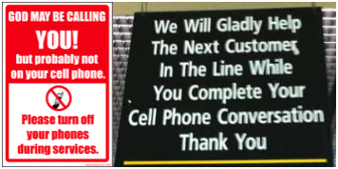

Slide 20
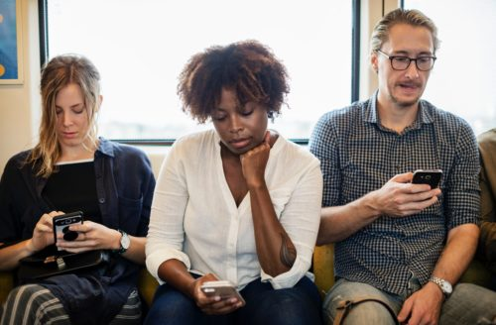

Slide 21
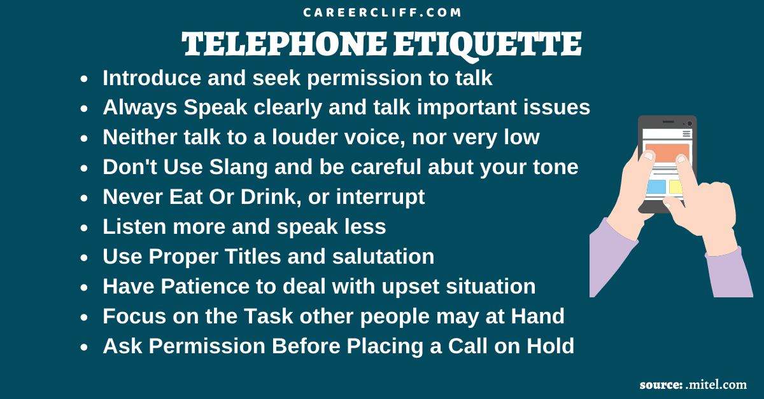

Slide 22
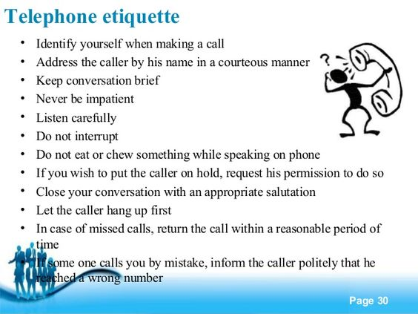

Slide 23
Here are some example topics, as they relate to phone conversations.
Modal verbs
Could I ask who’s calling, please?
How may I help you?
Expressions followed by verbs ending in “-ing”
Do you mind waiting a few minutes?
Thanks for calling.
Expressions followed by infinitives
I’m calling to clarify…
I’d like to leave him a message.
When is a good time to call?

Slide 24
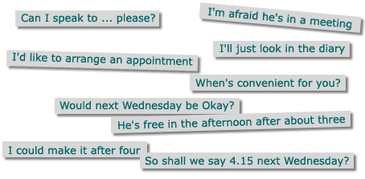

Slide 25
Thank you

Slide 26
Answering the phone (informal)
Hello. Matt here. (caller unknown)
Hi, Jody. How are you?
Hey, Justin. What's up?

Slide 27
Answering the phone (formal)
Hello? Serena speaking. (caller unknown)
John Sayles speaking. Who's calling, please? (caller unknown)
Doctor Martin's office. May I know who's calling, please? (caller unknown)
Thank you for calling Jeans Plus. Jody speaking.

Slide 28
Hello Maria. Nice to hear from you.
Hello Dr Jones. How can I help you?
City Library. Kim speaking. What can I do for you, Robert?

Slide 29
Introducing yourself
Hey George. It's Lisa calling. (informal)
Hello, this is Julie Madison calling.
Hi. It's Angelina from the dentist's office here. (informal)
Hello Sayoko. This is Alan calling from Big Boyz Autobody.
Asking to speak with someone
Hi. Is Nina there? (informal)

Slide 30
Can you put Michael on? (informal)
Can I talk to Josef? Tell him Marilyn's calling. (informal)
May I speak to Mr. Green in the accounting department, please?
Good morning. Is Dr Martin available, please?
Connecting someone
Just a sec. I'll get him. (informal)
Hang on a moment. I'll see if she's in. (informal)
One moment please. I'll see if he's available.

Slide 31
Hold the line please. I'll put you through in a moment.
Please hold while I put you through to the manager's office.
All of our staff are busy at this time. Please hold for the next available person.
Making a request
Could you please repeat that?
Would you mind spelling that for me?
Could you speak up a little, please?
Can you speak a little slower, please. My English isn't very good, I'm afraid.

Slide 32
Could you let me know when she'll be in the office, please?
Would you mind calling back in an hour? I'm in a meeting just now.
Can you call again? I think we have a bad connection.
Please hold for just a minute. I have another call.
Please don't call this number again.

Slide 33
Taking a message
Can I take a message?
Would you like to leave a message?
Sammy's not in. I can tell him you called if you like. (informal)
No, that's okay. I'll call him later. (informal)

Slide 34
I'm sorry, but Lisa's not here at the moment. Can I take a message?
I'm afraid he's stepped out. Would you like to leave a message?
She's busy right now. Would you like her to return your call?
He's in a meeting at the moment. Can he call you back when he's free?
Fine. I'll let him know you called.
I'll make sure she gets your message

Slide 35
Leaving a message
Can I leave a message?
Would you mind giving her a message?
Would it be possible to leave a message?

Slide 36
Could you tell her Jonathon called?
Could you ask him to call Paul when he gets in?
I don't think he has my number. Do you have a pen handy?
Thanks. It's James Brown and my number is 222 3456.

Slide 37
Confirming a message
Let me repeat that just to make sure. It's James Brown at 222 3456?
Was that 555 Charles Street, Apartment 66?

Slide 38
I'll make sure he gets the message.
It's Johnny, right? And you won't be at the club until midnight. (informal)
Okay, got it. I'll let him know. (informal)

Slide 39
Answering machine and voicemail phrases
Hey, Brad here. What's up? Let me know after the tone, OK? (informal)
Hi, this is Liz. I'm sorry I can't take your call right now, but if you leave a message after the tone I'll get back to you as soon as I can.
You've reached 222 6789. Please leave a message after the tone. Thank you.

Slide 40
Thank you for calling Dr. Mindin's office. Our hours are 9am to 5pm, Monday to Friday. Please call back during these hours or leave a message after the tone. If this is an emergency, please call the hospital at 333 7896.

Slide 41
You have reached Steve James, your guide to Computer Technology. Unfortunately, I can't take your call right now, but if you leave me a message and include your name and telephone number, I'll get back to you as soon as I can. You can also contact me via email at computech@XYZ.com. Thank you for calling.

Slide 42
Ending a conversation
Well, I guess I'd better get going. Talk again soon, OK? (informal)
Thanks for calling. Bye for now.
I have to let you go now.
I have another call coming through. I'd better run.
I'm afraid that's my other line.
I'll talk to you again soon. Bye Jules.

Slide 43
Leaving an answering machine or voicemail message
Hey Mikako. It's Yuka. Call me, OK? (informal)
Hello, this is Ricardo calling. Could you please return my call as soon as possible. My number is 334 5689. Thank you.

Slide 44
Hi Anderson. This is Marina from the doctor's office calling. I just wanted to let you know that you're due for a check-up this month. Please call us to make an appointment at your earliest convenience.

Slide 45
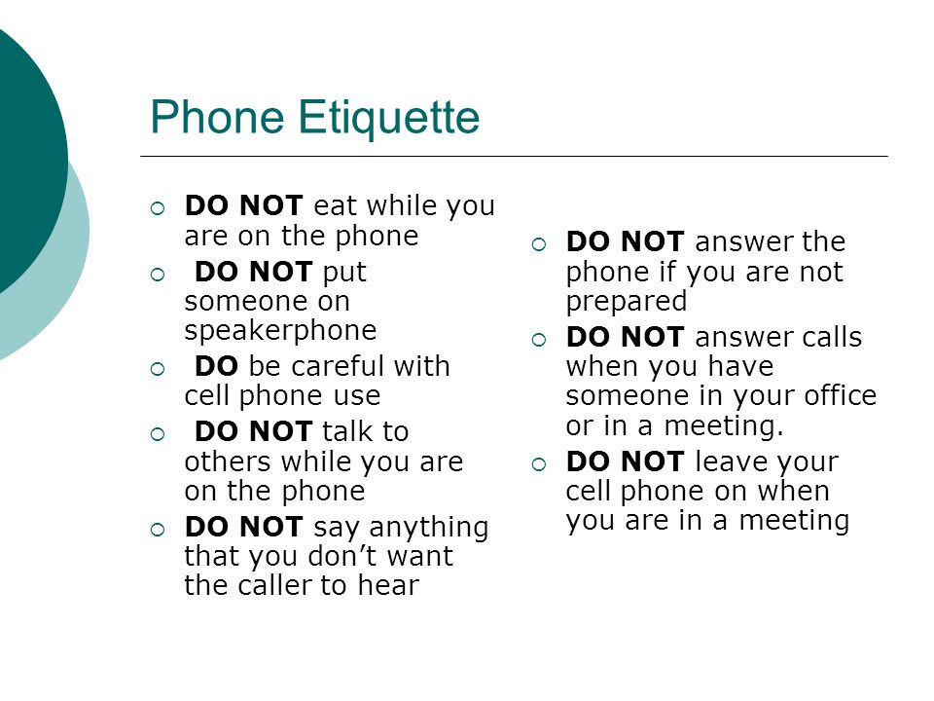
DONTS

Slide 46
References
https://blog.hubspot.com/service/phone-etiquette
https://www.careercliff.com/business-telephone-etiquette-tips/
https://in.pinterest.com/pin/721350065285445533/
https://www.fluentu.com/blog/business-english/business-english-telephone-phrases/
https://www.englishclub.com/speaking/telephone-phrases.htm

